Slide 1
Week 1: Introduction
Trials and Temptations

Slide 2
Pop Quiz
Please take a few minutes to complete the quiz
This is a closed-book quiz
We will review the questions as part of our introduction to the class

Slide 3
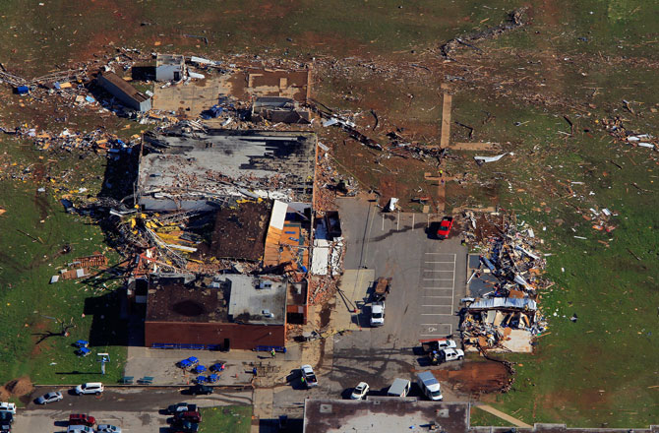
Question #1
Which of the following are valid sources of trials? (select all that apply)
√ Decisions a person makes
√ Persecution from the outside world
√ Sinful intentions from others
√ Random events
√ God
√ Satan

Slide 4
Question #2
Which of the following statements is true?
“Let no one say when he is tempted, ‘I am tempted by God’; for God cannot be tempted by evil, nor does He Himself tempt anyone.” ~ James 1:13(NKJV)

Slide 5
Question #3
What are some differences between trials and temptations?
Origin
Opportunity
Results
Closeness to God

Slide 6
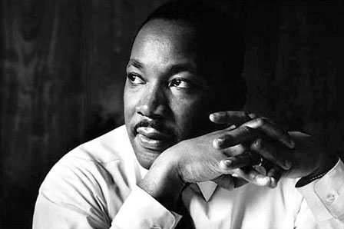
Question #4
How can a trial turn into temptation and sin?
“Complaining is dangerous business. It can damage or even destroy your relationship with God, your relationships with other people, and even with your relationship with yourself.” ~ Joyce Meyer
“Never succumb to the temptation of bitterness.”
~ Martin Luther King, Jr.

Slide 7
Question #5
Which of the following are valid sources of temptations? (select all that apply)
√ Our own desires
√ Other people
√ Satan
“But each one is tempted when he is drawn away by his own desires and enticed.” ~ James 1:13(NKJV)

Slide 8
Question #6
Who/what led Jesus into the wilderness to be tempted?
“Then Jesus was led up by the Spirit into the wilderness to be tempted by the devil.” ~ Matthew 4:1 (NKJV)

Slide 9
Question #7
Which of the following statements is false?
The Bible states there are two main types of sin – venial and mortal

Slide 10
Question #8
To what worldly temptation(s) did Eve succumb?
“So when the woman saw that the tree was good for food, that it was pleasant to the eyes, and a tree desirable to make one wise, she took of its fruit and ate. She also gave to her husband with her, and he ate.” ~ Genesis 3:6 (NKJV)

Slide 11
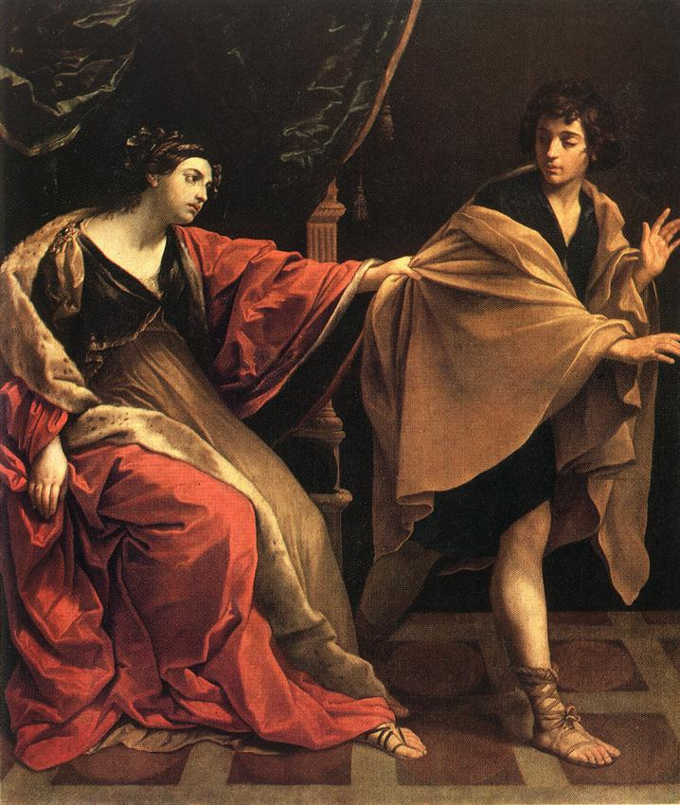
Question #9
What method(s) did Joseph use to resist temptation? (select all that apply)
√ He reasoned with Potiphar’s wife
√ He recognized sex with Potiphar’s wife would be a sin against God
√ He fled
Joseph and Potiphar’s Wife
by Guido Reni (1631)

Slide 12
Question #10
In light of 1 John 1:9 “If we confess our sins, He is faithful and just to forgive us our sins and to cleanse us from all unrighteousness” (NKJV), what danger does habitual sin pose for the Christian?

Slide 13
Question #11
What scriptures are meaningful to you for dealing with trials and/or temptations?

Slide 14
Schedule
Week # | Topic
1 | Introduction
2 | Defining Trials
3 | Lessons from Trials
4 | Strategies for Enduring Trials
5 | Defining Temptation
6 | Three Types of Temptations

Slide 15
Schedule
Week # | Topic
7 | Lust of the Flesh
8 | Lust of the Eye
9 | Pride of Life
10 | Recognizing Your Temptation(s)
11 | Temptation Strategies Part 1
12 | Temptation Strategies Part 2
13 | Stumbling, Falling, and Getting up

